Slide 1
Weekend Ready
Amrit Singh
Pavan Kumar Kamra
Deepanjali Gerangal

Slide 2




Customer representatives are complaining about slow data retrieval of warranty information.

Slide 3
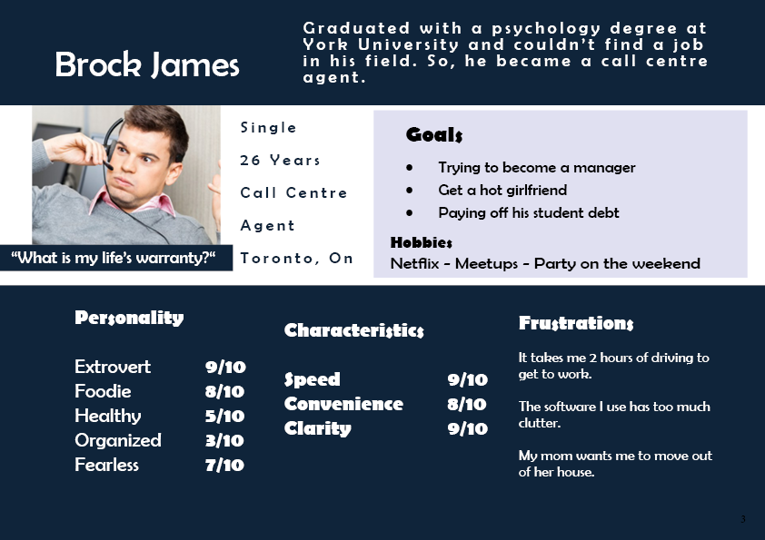

Slide 4
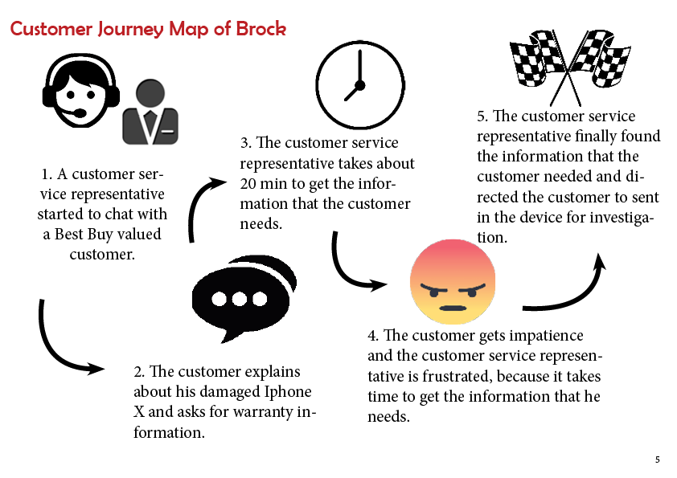

Slide 5
An easy-to-read web app where we can get all the necessary warranty information for customer service representatives in a fast way.
The Warranty Hub

